Slide 1
Integrated Mobile Applications Development
B.Sc. Web Technologies & Programming
Department of Computer Science & Applied Physics

Slide 2
Ionic Routing
As a user navigates throughout your app, Ionic is able to keep track of their navigation history.
Ionic uses the AngularUI Router module so app interfaces can be organized into various “states”.
The ionNavView directive is used to render templates in your application. Each template is part of a state.

Slide 3
Ionic Routing
Ionic organizes application interfaces (views) into States.
States are usually mapped to a URL, and defined programmatically.

Slide 4
ionNavView
<ion-nav-view></ion-nav-view>
.config(function($stateProvider, $urlRouterProvider) {
$stateProvider
.state('homeState', {
url: "/homeUrl",
templateUrl: 'templates/home.html'
});
$urlRouterProvider.otherwise('/homeUrl');
});

Slide 5
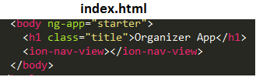
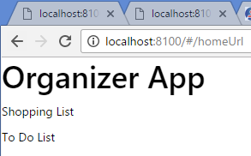
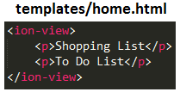
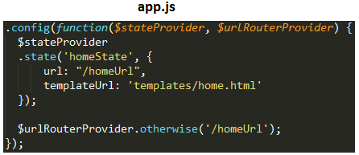

Slide 6
Ionic Routing
Instead of just displaying simple text, the text can be a link to a new State.
This means our application can have multiple States.

Slide 7
Ionic Routing
.config(function($stateProvider, $urlRouterProvider) {
$stateProvider
.state('homeState', {
url: "/homeUrl",
templateUrl: 'templates/home.html'
})
.state('shoppingListState',{
url: "/shoppingList",
templateUrl: "templates/shopping-list.html"
})
.state('toDoListState',{
url: "/toDoList",
templateUrl: "templates/todo-list.html"
});
$urlRouterProvider.otherwise('/homeUrl');
});

Slide 8
Ionic Routing
Instead of hard-coding data in a template, the data can be managed in a Controller associated with the State:
.config(function($stateProvider, $urlRouterProvider) {
$stateProvider
.state('homeState', {
url: "/homeUrl",
templateUrl: 'templates/home.html'
})
.state('shoppingListState',{
url: "/shoppingListUrl",
templateUrl: "templates/shopping-list.html",
controller: "shoppingListCtrl"
})

Slide 9
Ionic Routing
A State can have sub-States.
.state(‘parentState.childState’)….
.state('shoppingListState',{
url: "/shoppingListUrl",
templateUrl: "templates/shopping-list.html",
controller: "shoppingListCtrl"
})
.state('shoppingListState.shoppingItemState',{
url: "/:shoppingItemUrl",
templateUrl: "templates/shopping-item.html"
})

Slide 10
Ionic Routing
Just as the original index.html file has an ion-nav-view element, so must the parent state of the Child view have the ion-nav-view element
<ion-view>
:
<ion-nav-view></ion-nav-view>
</ion-view>

Slide 11
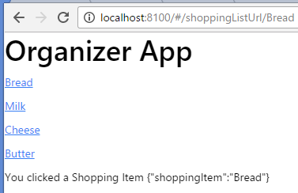


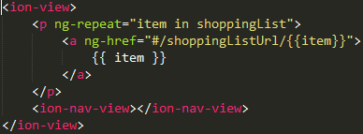

Ionic Routing – Passing Data
When we click on an item we want the name of the item displayed:
app.js
controllers.js
shopping-list.html
shopping-item.html

